Slide 1
Dining philosophers
Ricardo Barron-Silva
Skylar Ittner
Notes:
Hello everyone. Thank you all for coming. Today we will be talking about our coding project, and how we solved the dinning philosopher problem.

Slide 2

The Problem

Slide 3
30 Seconds
1 Minute
5 Minutes
10- Minutes

Slide 4
30 Seconds
1 Minute
5 Minutes
10- Minutes

Slide 6
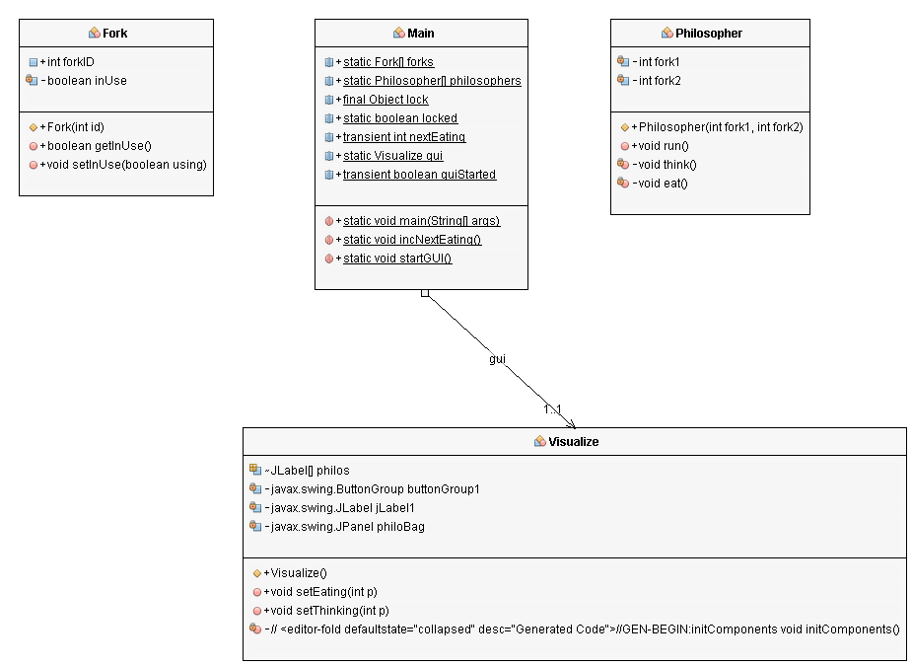
UML Diagram

